Slide 1
Getting Started
(1) Copy to your hard disk from a USB Key or DVD:
Copy needed files (VirtualBox, terminal, possibly an X server) for your platform (Win/Mac/Linux)
Copy Java 6 and Eclipse for your platform, if you want to use Java
Copy VM image: OpenFlowTutorial-101311.zip
Pass on the DVD or USB key to someone else!
(2) Unzip OpenFlowTutorial-101311.zip
(3) Point browser to instructions:
http://www.openflow.org/wk/index.php/OpenFlow_Tutorial (note the underscore)
You should NOT need to download any large files – spare the WiFi!

Slide 2
Tutorial 1: SDN for Engineers part of the the Open Networking Summit Santa Clara Marriott April 16, 2012
Brandon Heller, Rob Sherwood, David Erickson, Hideyuki Shimonishi, Srini Seetharaman, Murphy McCauley
only possible help from all the people
listed on the next few pages

Slide 3
Getting Started
(1) Copy to your hard disk from a USB Key or DVD:
Copy needed files (VirtualBox, terminal, possibly an X server) for your platform (Win/Mac/Linux)
Copy Java 6 and Eclipse for your platform, if you want to use Java
Copy VM image: OpenFlowTutorial-101311.zip
Pass on the DVD or USB key to someone else!
(2) Unzip OpenFlowTutorial-101311.zip
(3) Point browser to instructions:
http://www.openflow.org/wk/index.php/OpenFlow_Tutorial (note the underscore)
You should NOT need to download any large files – spare the WiFi!

Slide 4
Welcome
Notes:
Unprecedented scale

Slide 5
Who’s in this room?
Notes:
Unprecedented scale

Slide 6
Who’s in this room?
>= 3:
HP >= 19
Cisco >= 15
Juniper >= 7
Huawei >= 6
Brocade >= 4
ZAO >= 3
Google >= 3
Plus >= 60 companies w/2 or less..

Slide 7
Who’s in this room?
Engineer
Senior Engineer
Principal Systems Engineer
Distinguished Engineer
Senior Distinguished Engineer
Senior Technical Marketing Engineer
Notes:
All kinds of engineers

Slide 8
Who’s in this room?
Student
Graduate Student
PhD / Doctor
Senior Research Scientist
Professor

Slide 9
Who’s in this room?
CTO
VP
Founder
Solutions Architect
Cloud Architect
Chief Tech Expert
Chief

Slide 10
Goals
Notes:
Start out with some goals.

Slide 11
Overall Goal: think critically about SDN
Notes:
To understand the pieces, to understand how they fit together, what you can do with them, and how to fit into the developing ecosystem

Slide 12
Goals of this Tutorial
By the end, everyone should know:
Knowledge about SDN/OpenFlow
what these are
how they relate
what’s available now
where it’s going
how it’s used
SDN and You
how you can use it
how you can build on top of what’s available
How you can build something completely new
Have fun
Notes:
The standard: understand well enough to where you can comfortably tell someone about SDN

Slide 13
Agenda
Time | Description
9:00-10:00 | OpenFlow/SDN Introduction
10:00-10:30 | The SDN Stack, Part 1: Switches & Controllers
10:45-12:00 | The SDN Stack, Part 2: Virtualization & SDN Applications
12:00-1:00 | Lunch
1:00-3:00 | Controllers + Q&A
3:15-4:15 | Hands-On
4:20-5:00 | SDN Deployment Experiences and Wrap-up

Slide 14
SDN + OpenFlow History
Notes:
How did we get here.

Slide 15
Why OpenFlow? [Historical motivations, for researchers]
Notes:
To understand SDN, I think it make sense to start from a bottom-up approach, with OpenFlow.

Slide 16
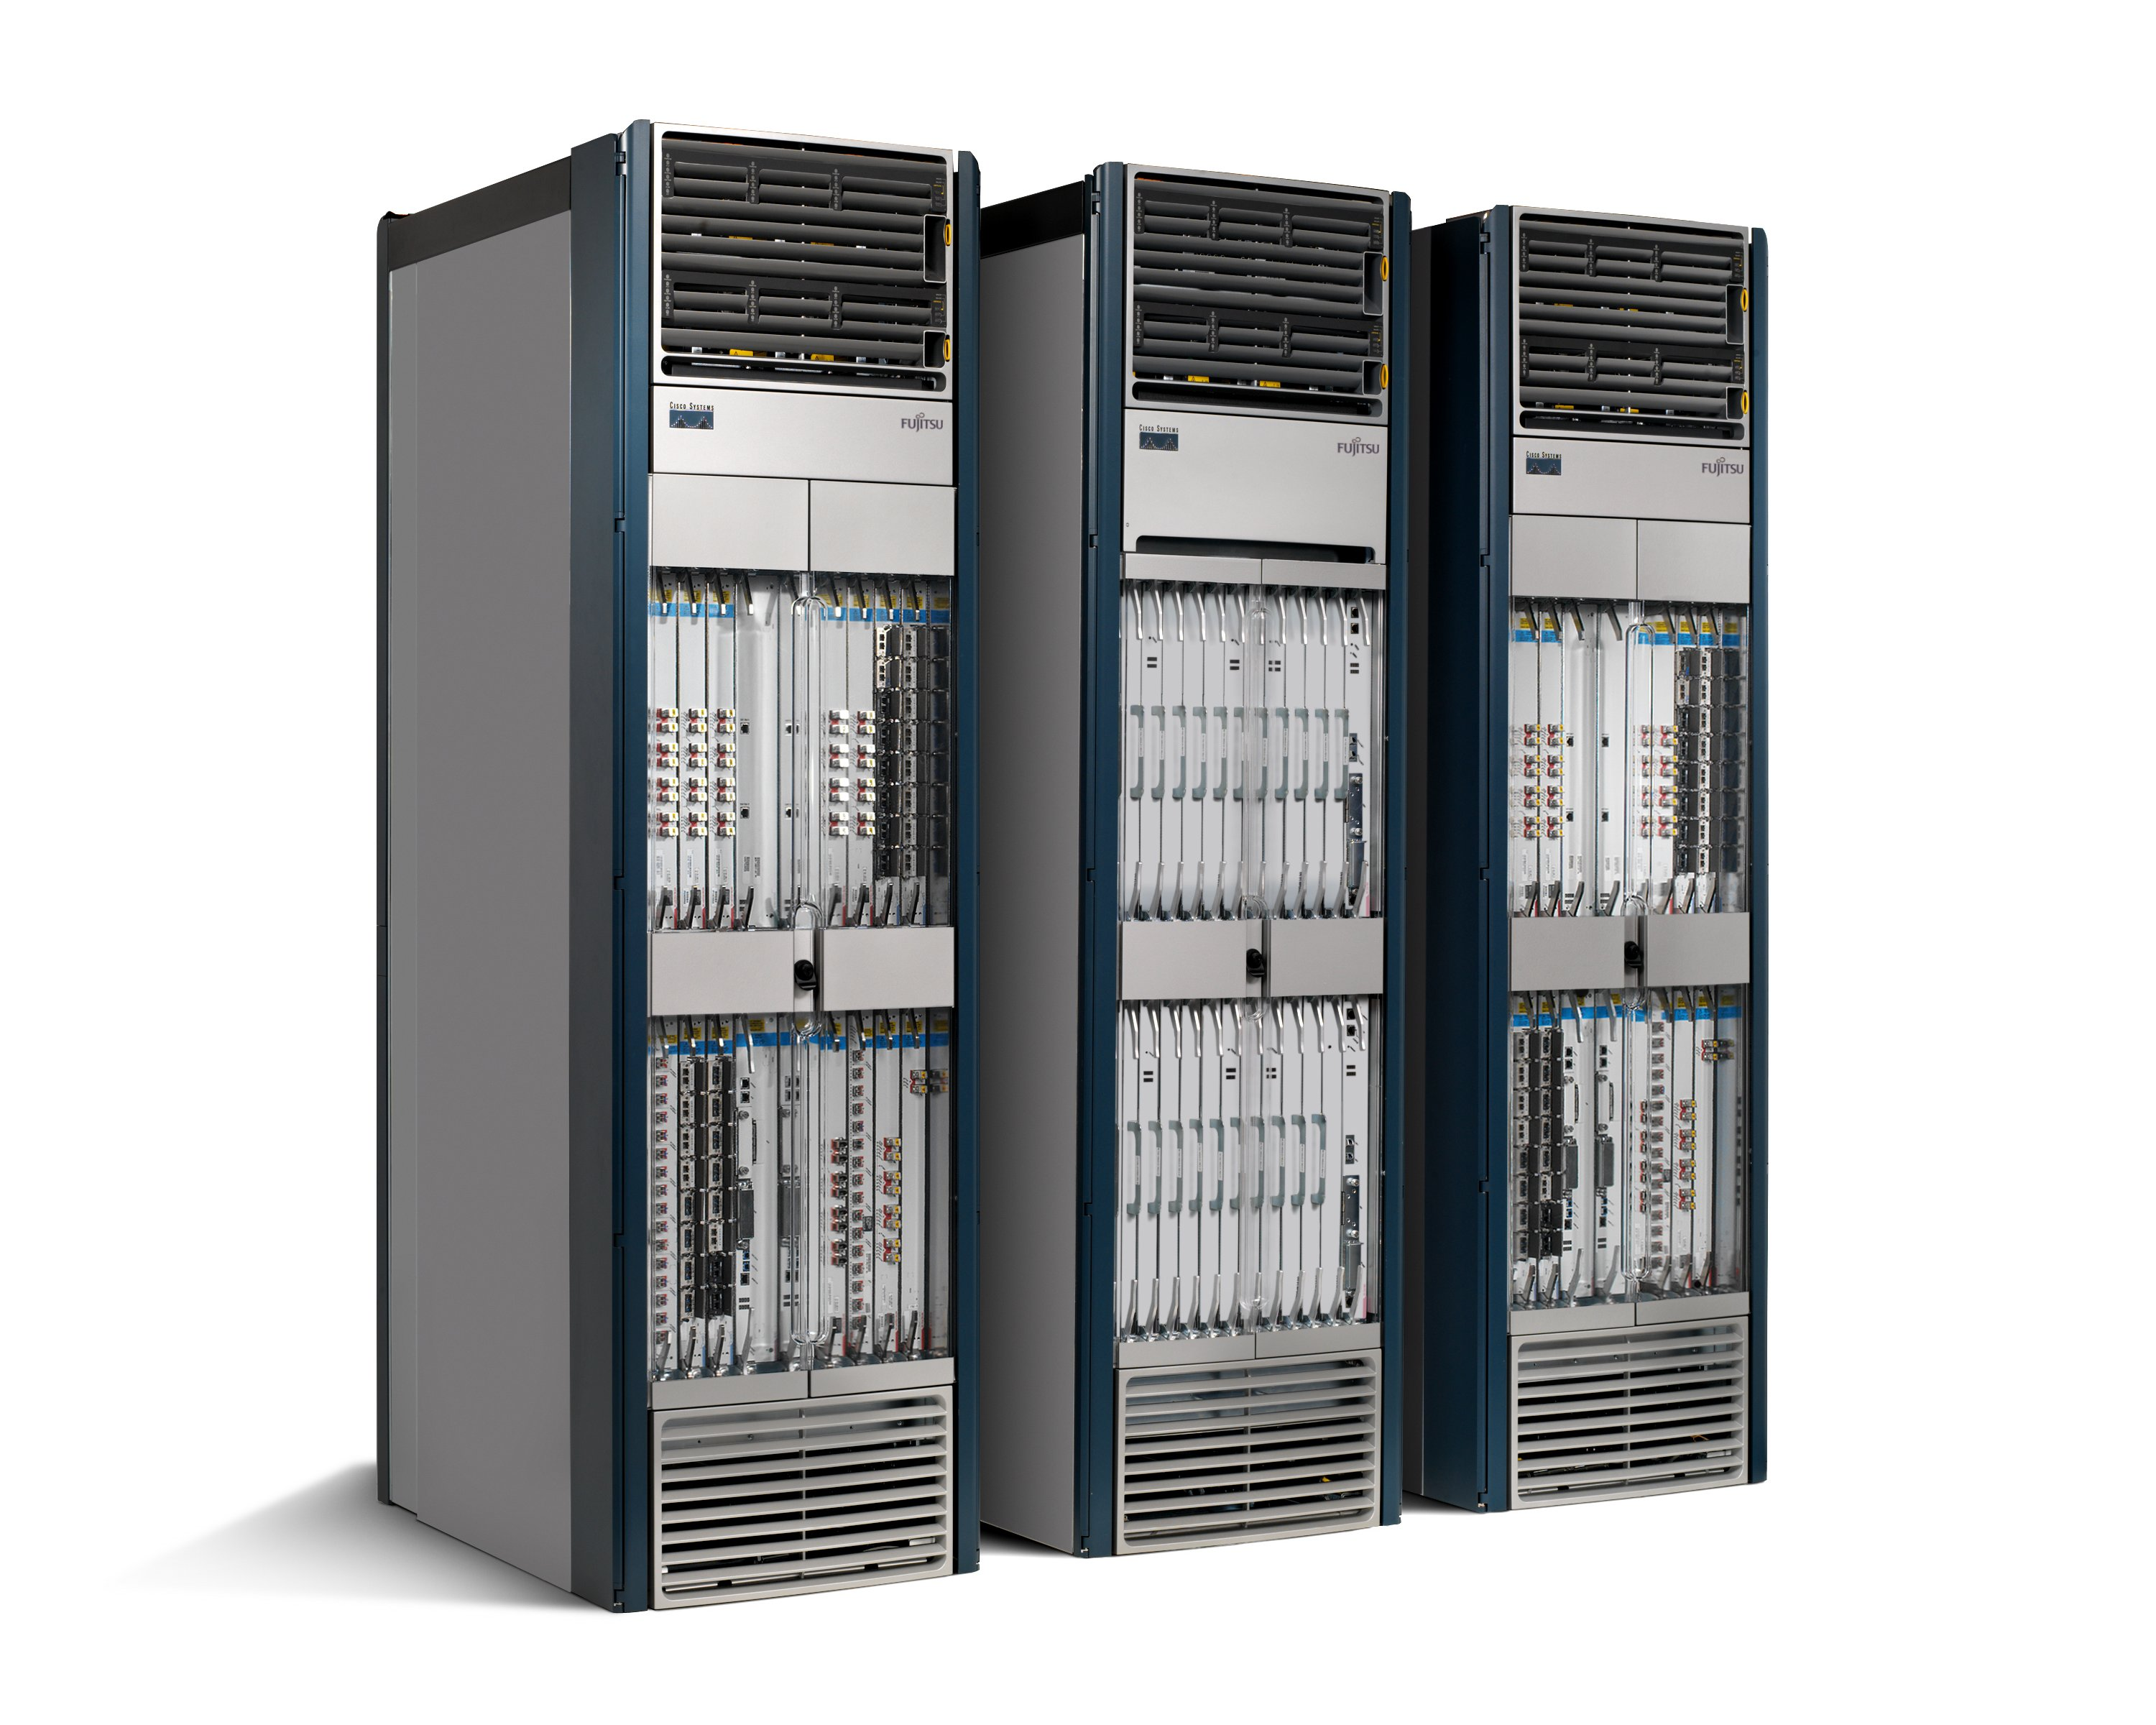

The Networking Industry (2007)
Routing, management, mobility management, access control, VPNs, …
Feature
Feature
Million of lines of source code
5400 RFCs
Barrier to entry
Operating
System
Specialized Packet Forwarding Hardware
Billions of gates
Complex
Power Hungry
Many complex functions baked into the infrastructure
OSPF, BGP, multicast, differentiated services, Traffic Engineering, NAT, firewalls, MPLS, redundant layers, …
An industry with a “mainframe-mentality”
Little ability for non-telco network operators to get what they want
Functionality defined by standards, put in hardware, deployed on nodes
16
Notes:
16
The networking industry is broken. Why doesn’t it look like the server market? Historical accident.
Overwhelming complexity.
The history of OpenFlow starts with a realization that the state of the industry is broken.
Analogy: like the computer industry in the late 70’s and early 80’s before IBM compatibles and Windows: vertically integrated.

Slide 17
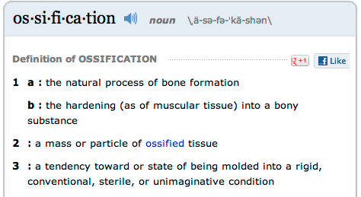
Ossification
Source: http://www.merriam-webster.com/
Notes:
One effect of ossification is research stagnation.

Slide 18
Research Stagnation (circa 2007): Faster networks but not better networks
Lots of deployed innovation in other areas
OS: filesystems, schedulers, virtualization
DS: DHTs, CDNs, MapReduce
Compilers: JITs, new language paradigms
Networks are largely the same as years ago
Ethernet, IP, WiFi
Rate of change of the network seems slower in comparison
Need better tools and abstractions to demonstrate and deploy
Notes:
In these other areas, you can real systems on top of high-quality, open platforms, and you don’t need to reinvent the wheel
Faster, but not better

Slide 19
Another problem: Closed Systems (Vendor Hardware)
Can’t extend
Stuck with interfaces (CLI, SNMP, etc)
Hard to meaningfully extend
Hard to meaningfully collaborate
Vendors starting to open up, but not usefully
Notes:
Furthermore, researchers in particular have this problem of closed system.
Ideally, the way networking research works is that you come up with some idea of how something should work, and progressively increase the scale until it looks and feels real.

Slide 20
Open Systems
 | Performance Fidelity | Scale | Real User Traffic? | Complexity | Open
Simulation | medium | medium | no | medium | yes
Emulation | medium | low | no | medium | yes
Software Switches | poor | low | yes | medium | yes
NetFPGA | high | low | yes | high | yes
Network Processors | high | medium | yes | high | yes
Vendor Switches | high | high | yes | low | no
gap in the tool space
none have all the desired attributes!
Notes:
So academics went out and made their own systems.

Slide 21




Ethane, a precursor to OpenFlow Centralized, reactive, per-flow control
Controller
Flow Switch
Flow Switch
Flow Switch
Host B
Host A
Flow Switch
See Ethane SIGCOMM 2007 paper for details
Notes:
Realization: simply separating forwarding devices from their control logic enables a completely different way of using the network.

Slide 22
Ethane’s dumb, simple switches might be more broadly useful…
Notes:
We’re been talking in the abstract; now, let’s move to the concrete

Slide 23
OpenFlow: a pragmatic compromise
+ Speed, scale, fidelity of vendor hardware
+ Flexibility and control of software and simulation
+ Vendors don’t need to expose implementation
+ Leverages hardware inside most switches today (ACL tables)
Least-common-denominator interface may prevent using all hardware features
Limited table sizes
Switches not designed for this
New failure modes to understand
Notes:
Researcher’s view of OpenFlow.
No technical insights, just practical ones.
You get all the properties of vendor hardware, for good or bad.

Slide 24
How does OpenFlow work?

Slide 25
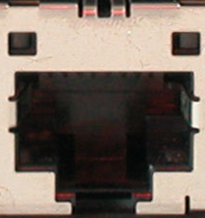
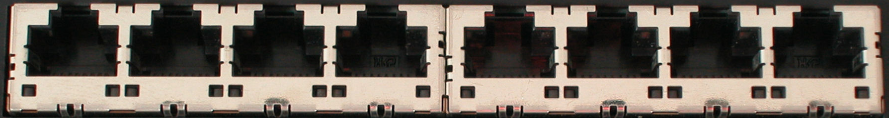
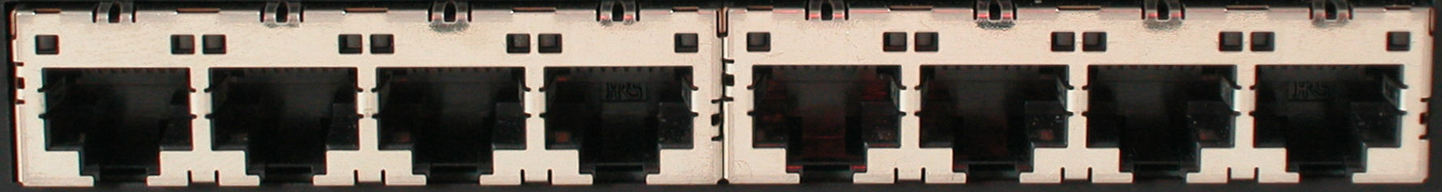
Ethernet Switch

Slide 26
Control Path
Control Path (Software)
Data Path (Hardware)

Slide 27
OpenFlow Controller
OpenFlow Protocol (SSL/TCP)
Control Path
OpenFlow
Data Path (Hardware)

Slide 28
OpenFlow Example
Controller
OpenFlow Client
PC
Software
Layer
Flow Table
MAC
src
MAC
dst
IP
Src
IP
Dst
TCP
sport
TCP
dport
Action
Hardware
Layer
*
*
*
5.6.7.8
*
*
port 1
port 1
port 2
port 3
port 4
5.6.7.8
1.2.3.4

Slide 29
OpenFlow Basics Flow Table Entries
Rule
Action
Stats
Packet + byte counters
Forward packet to zero or more ports
Encapsulate and forward to controller
Send to normal processing pipeline
Modify Fields
Any extensions you add!
Switch
Port
VLAN
ID
VLAN
pcp
MAC
src
MAC
dst
Eth
type
IP
Src
IP
Dst
IP
ToS
IP
Prot
L4
sport
L4
dport
+ mask what fields to match
Notes:
Now I’ll describe the API that tries to meet these goals.

Slide 30
Examples
Switching
Switch
Port
MAC
src
MAC
dst
Eth
type
VLAN
ID
IP
Src
IP
Dst
IP
Prot
TCP
sport
TCP
dport
Action
*
*
00:1f:..
*
*
*
*
*
*
*
port6
Flow Switching
Switch
Port
MAC
src
MAC
dst
Eth
type
VLAN
ID
IP
Src
IP
Dst
IP
Prot
TCP
sport
TCP
dport
Action
port3
00:20..
00:1f..
0800
vlan1
1.2.3.4
5.6.7.8
4
17264
80
port6
Firewall
Switch
Port
MAC
src
MAC
dst
Eth
type
VLAN
ID
IP
Src
IP
Dst
IP
Prot
TCP
sport
TCP
dport
Action
*
*
*
*
*
*
*
*
*
22
drop

Slide 31
Examples
Routing
Switch
Port
MAC
src
MAC
dst
Eth
type
VLAN
ID
IP
Src
IP
Dst
IP
Prot
TCP
sport
TCP
dport
Action
*
*
*
*
*
*
5.6.7.8
*
*
*
port6
VLAN Switching
Switch
Port
MAC
src
MAC
dst
Eth
type
VLAN
ID
IP
Src
IP
Dst
IP
Prot
TCP
sport
TCP
dport
Action
port6,
port7,
port9
*
*
00:1f..
*
vlan1
*
*
*
*
*

Slide 32
OpenFlow is not enough.

Slide 33
OpenFlow is not enough…
Adds the ability to modify, experiment…
But still harder than it should be to add features to a network
Effectively assembly programming or an ISA
[OpenFlow is just a forwarding table management protocol]
Notes:
Great first step that give researchers and network operators new flexibility, but it doesn’t solve the larger problems.

Slide 34
It’s hard to add a feature to a network
It’s not just that we lack access to line-rate forwarding that we can control
Fully distributed algorithms are hard, especially when defined at the protocol level
Your protocol must implement its own mechanisms
Must work on constrained and heterogeneous resources
This is where Software-Defined Networking comes in: need a control plane abstraction too

Slide 35
From OpenFlow to SDN
Notes:
First off, what exactly does it mean?

Slide 36
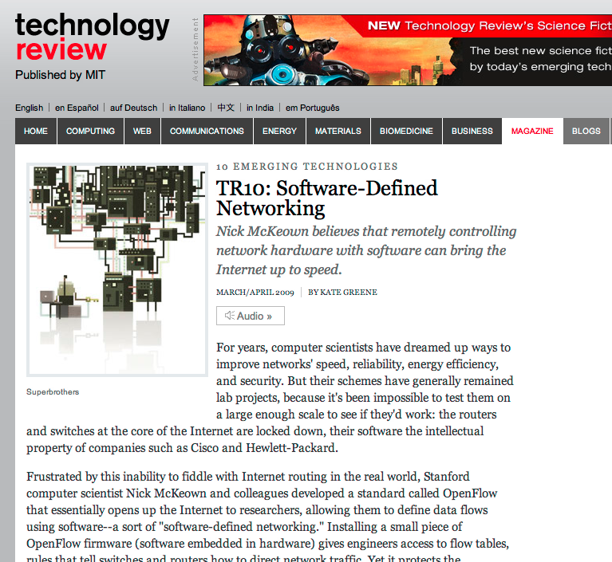

Slide 37
SDN is actually much older than ‘09
Key ideas present in some form in 4D, RCP, Sane, Ethane, …

Slide 38
What is SDN, opt. 1 “The McKeown View”: Refactoring Functionality

Slide 39
Define SDN by its placement of functionality.
Notes:
We’re been talking in the abstract; now, let’s move to the concrete

Slide 40
Today
Closed Boxes, Fully Distributed Protocols
Closed
App
App
App
Operating
System
Specialized Packet Forwarding Hardware
App
App
App
Operating
System
App
App
App
Specialized Packet Forwarding Hardware
Operating
System
App
App
App
Specialized Packet Forwarding Hardware
Operating
System
Specialized Packet Forwarding Hardware
App
App
App
Operating
System
Specialized Packet Forwarding Hardware
40
Notes:
Historical artifact that forwarding boxes host the code too. Leads to a specific design point for networks. Great for the internet, not so much for the networks the internet connects.
Note each piece.

Slide 41
“Software Defined Networking” approach to open it
App
App
App
Network Operating System
App
App
App
Operating
System
Specialized Packet Forwarding Hardware
App
App
App
Operating
System
App
App
App
Specialized Packet Forwarding Hardware
Operating
System
App
App
App
Specialized Packet Forwarding Hardware
Operating
System
Specialized Packet Forwarding Hardware
App
App
App
Operating
System
Specialized Packet Forwarding Hardware
41
Notes:
How do we redefine the architecture to open up networking infrastructure and the industry!
By bring to the networking industry what we did to the computing world

Slide 42
The “Software-defined Network”
2. At least one good operating system
Extensible, possibly open-source
3. Well-defined open API
App
App
App
Network Operating System
1. Open interface to hardware
Simple Packet Forwarding Hardware
Simple Packet Forwarding Hardware
Simple Packet Forwarding Hardware
Simple Packet Forwarding Hardware
Simple Packet Forwarding Hardware
42
Notes:
Switches, routers and other middleboxes are dumbed down
The key is to have a standardized control interface that speaks directly to hardware

Slide 43
Isolated “slices”
Many operating systems, or
Many versions
App
App
App
App
App
App
App
App
Network Operating System 1
Network Operating System 2
Network Operating System 3
Network Operating System 4
Open interface to hardware
Virtualization or “Slicing” Layer
Open interface to hardware
Simple Packet Forwarding Hardware
Simple Packet Forwarding Hardware
Simple Packet Forwarding Hardware
Simple Packet Forwarding Hardware
Simple Packet Forwarding Hardware

Slide 44
What is SDN, opt. 2 “The Shenker View”: Redefining Abstractions
Notes:
Not just about where the functionality is implemented, but about defining a new set of abstractions for thinking about those interface

Slide 45
Define SDN by the abstractions it provides to software (and people writing it).
Notes:
We’re been talking in the abstract; now, let’s move to the concrete

Slide 46
“The Shenker View”
Scott Shenker has a killer presentation
(Keynote at last ONS)
You should watch this
http://www.slideshare.net/martin_casado/sdn-abstractions
The Future of Networking, and the Past of Protocols
Many bullet points on next few slides are from this talk

Slide 47
“The Shenker View”: the gist
Network control planes need abstractions
Abstractions solve architectural problems and enable evolvability
Today’s layers (L2, L3, ..) are good abstractions but terrible for control interfaces
Networks work because we can master complexity
but what we should be doing is extracting simplicity, with the right abstractions
Notes:
Today’s layering abstractions are great for application developers but terrible for network developers.

Slide 48
Programming Made the Transition
Machine Languages: no abstractions
Higher-level languages, OS + other abstraction
files, virtual memory, data structures, …
Modern languages: even more abstractions
objects, garbage collection, threads, locks, …
Abstractions simplify programming: they make it easier to write, maintain, and reason about programs.
Could networking follow this same path?

Slide 49
Forwarding Abstraction
Forwarding behavior specified by a control program.
Possibilities: x86, MPLS, OpenFlow

Slide 50
State Distribution Abstraction
Control program should not have to handle distributed-state details
Proposed abstraction: global network view
Control program operates on network view
Input: global network view (graph)
Output: configuration of each network device
Network OS provides network view
Short version: programs operate on graphs
Notes:
Note difference between being asked to build OSPF vs implementing Dijskstra’s algorithm.

Slide 51
Specification Abstraction
Give control program abstract view of network
Provide enough detail to specify goals, but not to implement them

Slide 52
What is SDN, opt 3 My view: Opening Up Design Axes
Notes:
Def’n that’s not focused on system itself, but what we can do with it. Slightly more general definition.

Slide 53
Define SDN not by what it looks like or how we think about it, but the flexibility it provides.
Notes:
We’re been talking in the abstract; now, let’s move to the concrete

Slide 54
SDN opens up implementation design axes.
Notes:
We’re been talking in the abstract; now, let’s move to the concrete

Slide 55
An SDN is any network that gives us the flexibility to choose between points on the following design axes.
Notes:
Regardless of implementation. This has been a little abstract, so let’s get to the concrete specifics.

Slide 56

Centralized vs Distributed Control
Centralized Control
Distributed Control
Controller
Controller
OpenFlow
Switch
OpenFlow
Switch
Controller
OpenFlow
Switch
OpenFlow
Switch
Controller
OpenFlow
Switch
OpenFlow
Switch

Slide 57
Microflow vs. Aggregated
Microflow
Every flow is individually set up by controller
Exact-match flow entries
Flow table contains one entry per flow
Good for fine grain control, policy, and monitoring, e.g. campus
Aggregated
One flow entry covers large groups of flows
Wildcard flow entries
Flow table contains one entry per category of flows
Good for large number of flows, e.g. backbone

Slide 58
Reactive vs. Proactive (pre-populated)
Reactive
First packet of flow triggers controller to insert flow entries
Efficient use of flow table
Every flow incurs small additional flow setup time
If control connection lost, switch has limited utility
Extremely simple fault recovery
Proactive
Controller pre-populates flow table in switch
Zero additional flow setup time
Loss of control connection does not disrupt traffic
Essentially requires aggregated (wildcard) rules
Notes:
Simple fault recovery but not necessarily simple or optimal

Slide 59
Virtual vs Physical
Virtual
Assumes configurable switching within a host: in the OS or hypervisor
Software! Memory, processing, arbitrary modifications
Massive flow rates
Limited to the hardware below
Physical
No assumption of software changes; unmodified end hosts
Greater control over expensive forwarding resources

Slide 60
Fully Consistent vs Eventually Consistent
Fully Consistent
Certainty about state
Consistent state is harder to scale
Easier to reason about state and its transitions
May eliminate route flaps
Eventually Consistent
Uncertainty about state now, but eventually converges
Probabilistic state is easier to scale
Introduces the possibility of long-lived route flaps and unstable control systems
Notes:
Also inconsistent; could be degree of consistency, but inconsistent generally not so useful.

Slide 61
Here’s a picture
Notes:
Regardless of implementation. This has been a little abstract, so let’s get to the concrete specifics.

Slide 62
These axes, today (BGP):
Centralized
Distributed
Microflow
Aggregated
Reactive
Proactive
Virtual
Physical
Fully Consistent
Eventually Consistent
Many choices arise from assuming decentralized administration…
Notes:
Five orthogonal axes

Slide 63
These axes, for Ethane
Centralized
Distributed
Microflow
Aggregated
Reactive
Proactive
Virtual
Physical
Fully Consistent
Eventually Consistent
Many choices arise from assuming centralized administration…

Slide 64
These axes, for Hedera:
Centralized
Distributed
Microflow
Aggregated
Reactive
Proactive
Virtual
Physical
Fully Consistent
Eventually Consistent
Hedera controls a data center network.
See NSDI ‘10 paper for more details.

Slide 65
Your SDN network or application?
Centralized
Distributed
Microflow
Aggregated
Reactive
Proactive
Virtual
Physical
Fully Consistent
Eventually Consistent
Hybrid approaches often have desirable properties; can use these now.

Slide 66
Example applications and their places on the scales

Slide 67
High-order bit of SDN: adds flexibility to control-plane implementation choices

Slide 68
SDN examples using OpenFlow Many applications benefit from flexibility
Stanford Demos
Others
Wireless mobility
VM mobility/migration
Network virtualization
Power management
Hardware
Load balancing
Traffic Engineering
Removing spanning tree
Network visualization
Network debugging
Packet-circuit convergence
Home networks
Flexible access control
Scale-out routers
Scale-out data centers

Slide 69
What SDN really means is up in the air. Here’s a good definition, though: Software Defined Networking (SDN) is a refactoring of the relationship between network devices and the software that controls them. [Paraphrased from the HotSDN ‘12 Solicitation]
Notes:
We’re been talking in the abstract; now, let’s move to the concrete

Slide 70
The SDN Stack

Slide 71
The SDN Stack
oftrace
oflops
openseer
Monitoring/ debugging tools
ENVI (GUI)
LAVI
n-Casting
…
Applications
NOX
Beacon
Trema
Maestro
…
Controller
Slicing
Software
FlowVisor
Console
FlowVisor
Commercial Switches
Software
Ref. Switch
NetFPGA
Broadcom
Ref. Switch
HP, NEC, Pronto, Juniper.. and many more
OpenFlow
Switches
OpenWRT
PCEngine WiFi AP
Open vSwitch
71
Notes:
There are components at different levels that work together in making it work
The commercial switch details will follow in next slide
There are a plethora of applications possible. I only list those available at Stanford

Slide 72
Switches (all OpenFlow 1.0 for now)

Slide 73
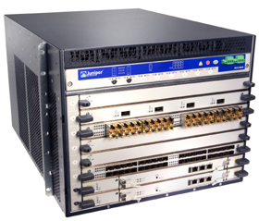
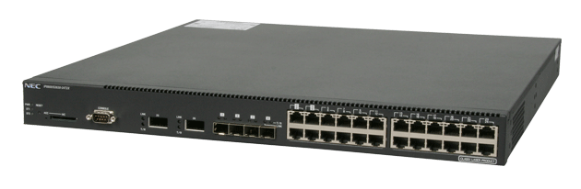
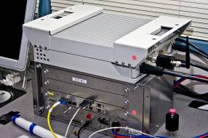
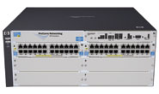
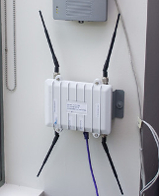
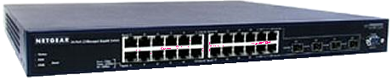
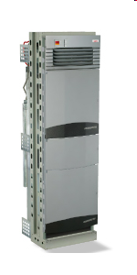

Current SDN hardware (as of ~2010)
Juniper MX-series
NEC IP8800
WiMax (NEC)
HP Procurve 5400
Netgear 7324
PC Engines
Pronto 3240/3290
Ciena Coredirector
Ask your vendors
73

Slide 74
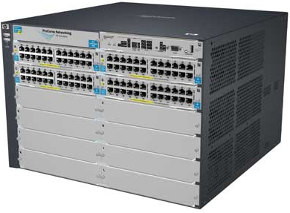
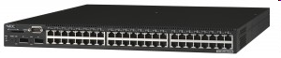
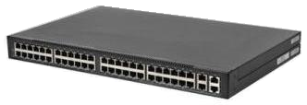
Commercial Switches
Vendor | Models | Virtualize? | Notes | Pic
HP ProCurve | 5400zl, 6600, + | 1 OF instance per VLAN | LACP, VLAN and STP processing before OpenFlow Wildcard rules or non-IP pkts processed in s/w Header rewriting in s/w CPU protects mgmt during loop
NEC | IP8800, + | 1 OF instance per VLAN | OpenFlow takes precedence Most actions processed in hardware MAC header rewriting in h/w
Pronto/Pica8 | 3290, 3780, 3920, + | 1 OF instance per switch | No legacy protocols (like VLAN and STP) Most actions processed in hardware MAC header rewriting in h/w
Notes:
Language open-source Performance cross-platform runtime modular

Slide 75
Open Switches
Name | Lang | Platform(s) | License | Original Author | Notes
OpenFlow Reference | C | Linux | OpenFlow License | Stanford/Nicira | not designed for extensibility
Open vSwitch | C/Python | Linux/BSD? | Apache 2.0 | Ben Pfaff/Nicira | In Linux kernel 3.3+
Indigo | C/Lua | Linux-based Hardware Switches | GPL v2 | Dan Talayco/BigSwitch | Bare OpenFlow switch
Xorplus | ? | Linux-based Hardware Switches | ? | Pica8 | Support
Notes:
Language open-source Performance cross-platform runtime modular

Slide 76
Ignore these slides. Ask your vendor for the latest.

Slide 77
What you cannot do with OpenFlow v1.0
Non-flow-based (per-packet) networking
ex. Per-packet next-hop selection (in wireless mesh)
yes, this is a fundamental limitation
BUT OpenFlow can provide the plumbing to connect these systems
Use all tables on switch chips
yes, a major limitation (cross-product issue)
BUT OF version 1.1 exposes these, providing a way around the cross-product state explosion

Slide 78
What can cannot do with OpenFlow v1.0 (2)
New forwarding primitives
BUT provides a nice way to integrate them through extensions
New packet formats/field definitions
BUT extensible matches are coming in v1.2/1.3+
Optical Circuits
BUT efforts underway to apply OpenFlow model to circuits
Low-setup-time individual flows
BUT can push down flows proactively to avoid delays

Slide 79
Where it’s going
OF v1.0: released end of 2009: “Into the Campus”
OF v1.1: released March 1 2011: “Into the WAN”
multiple tables: leverage additional tables
tags and tunnels: MPLS, VLAN, virtual ports
multipath forwarding: ECMP, groups
OF v1.2: approved Dec 8 2011: “Extensible Protocol”
extensible match
extensible actions
IPv6
multiple controllers

Slide 80
Controllers

Slide 81
Open Controllers
Name | Lang | Platform(s) | License | Original Author | Notes
OpenFlow Reference | C | Linux | OpenFlow License | Stanford/Nicira | not designed for extensibility
NOX | Python, C++ | Linux | GPL | Nicira | actively developed
Beacon | Java | Win, Mac, Linux, Android | GPL (core), FOSS Licenses for your code | David Erickson (Stanford) | runtime modular, web UI framework, regression test framework
Maestro | Java | Win, Mac, Linux | LGPL | Zheng Cai (Rice)
Trema | Ruby, C | Linux | GPL | NEC | includes emulator, regression test framework
RouteFlow | ? | Linux | Apache | CPqD (Brazil) | virtual IP routing as a service
Notes:
Language open-source Performance cross-platform runtime modular

Slide 82
Open Controllers (2)
Name | Lang | Platform(s) | License | Original Author | Notes
OpenFaucet | Python |  |  |  | Library
Mirage | OCaml
POX | Python | Any
Floodlight | Java | Any |  | BigSwitch, based on Beacon
Too many to easily list of keep track of…
Notes:
Language open-source Performance cross-platform runtime modular

Slide 83
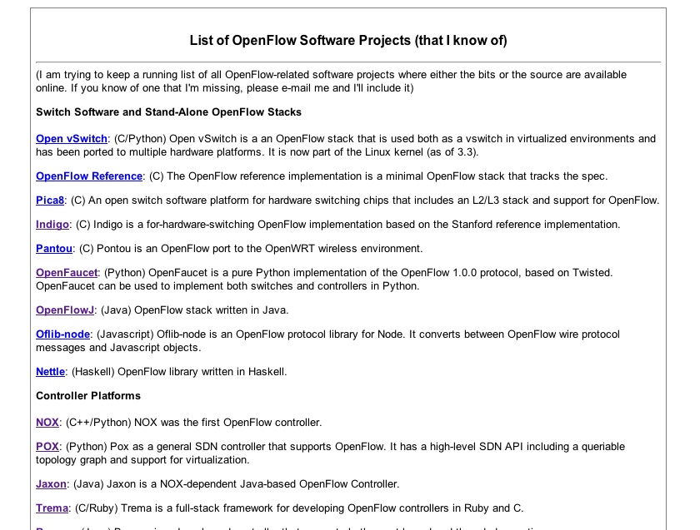
Growing list….
Martin Casado recently added a list:
http://yuba.stanford.edu/~casado/of-sw.html

Slide 84
Related Research
DIFANE
Rule partitioning for controller-less flow insertion
UCSD Fat Tree Series: Scalable Commodity Data Center, PortLand, Hedera
Scale-out data centers that use OpenFlow
Tesseract
Centralized WAN in the 4D Architecture
ONIX
Fault-tolerant controller platform from Nicira, Google, NEC
DevoFlow
Practical scalability limits to OpenFlow and modifications to get around them

Slide 85
Related Research
Frenetic/Nettle
Functional Reactive Programming for more composable, reusable controller code
Resonance
State-machine-based network control
Consistency Primitives
Per-packet or per-flow routing guarantees to simplify network versioning

Slide 86
Up Next:
Come back at 10:45 for:
“The SDN Stack Part 2: Virtualization and SDN Applications”

Slide 87
Getting Started
(1) Copy to your hard disk from a USB Key or DVD:
Copy needed files (VirtualBox, terminal, possibly an X server) for your platform (Win/Mac/Linux)
Copy Java 6 and Eclipse for your platform, if you want to use Java
Copy VM image: OpenFlowTutorial-101311.zip
Pass on the DVD or USB key to someone else!
(2) Unzip OpenFlowTutorial-101311.zip
(3) Point browser to instructions:
http://www.openflow.org/wk/index.php/OpenFlow_Tutorial (note the underscore)
You should NOT need to download any large files – spare the WiFi!

Slide 88
Virtualization and SDN Applications

Slide 89
Virtualization Rob Sherwood, (BigSwitch)

Slide 90
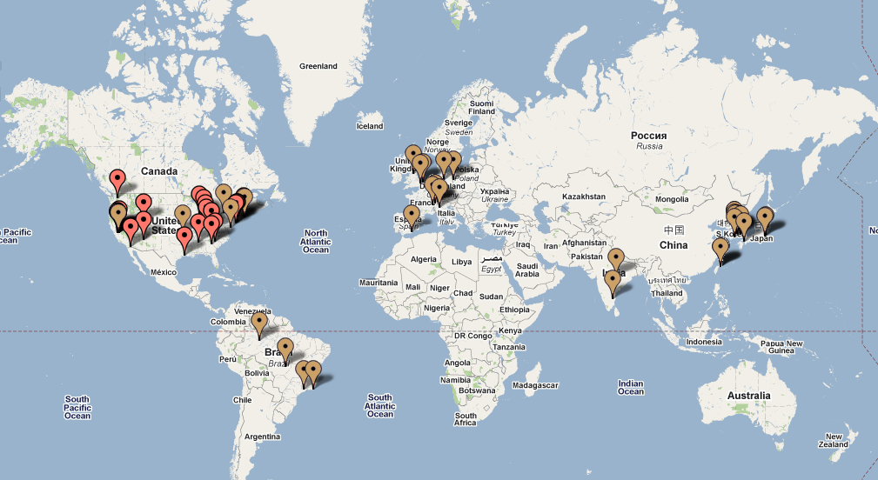
Current Trials
68 trials/deployments spanning 13 countries

Slide 91
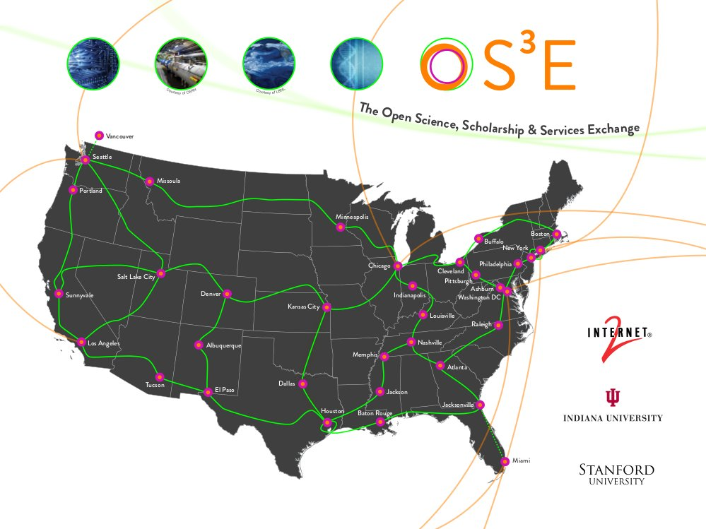
Internet2 OpenFlow deployment initiative. 35+ 100G POPs, nationwide.

Slide 92
Applications of SDN

Slide 93
OpenFlow Demonstration Overview
Topic
Demo
Network Virtualization | FlowVisor
Hardware Prototyping | OpenPipes
Load Balancing | PlugNServe
Energy Savings | ElasticTree
Mobility | MobileVMs
Traffic Engineering | Aggregation
Wireless Video | OpenRoads

Slide 94
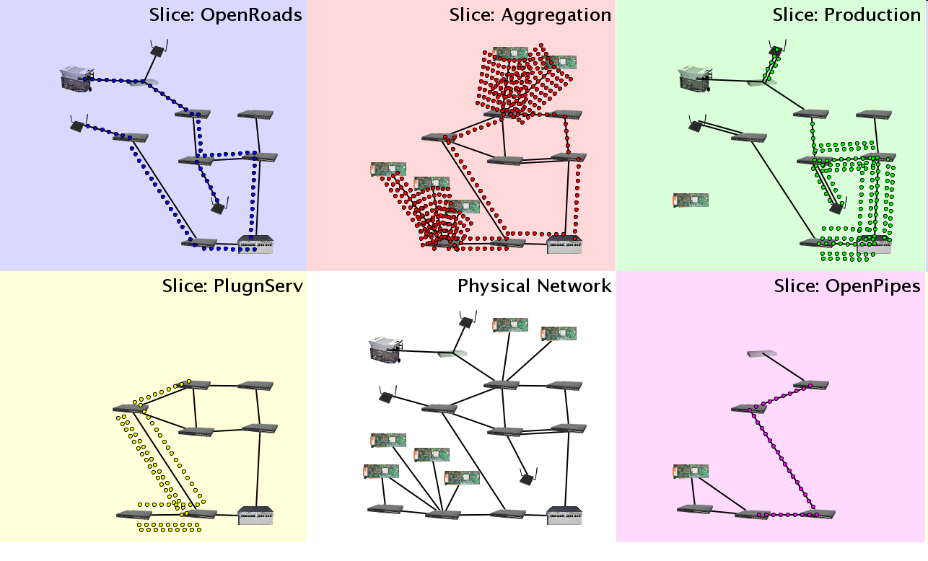
Demo Infrastructure with Slicing
WiMax
WiFi APs
OpenFlow switches
Flows
Packet processors

Slide 95



FlowVisor Creates Virtual Networks
OpenPipes
Demo
OpenRoads
Demo
PlugNServe
Load-balancer
Each demo presented here runs in an isolated slice of Stanford’s production network.
OpenFlow
Protocol
OpenFlow
Protocol
OpenFlow
Switch
FlowVisor
OpenPipes
Policy
FlowVisor slices OpenFlow networks, creating multiple isolated and programmable logical networks on the same physical topology.
OpenFlow
Switch
OpenFlow
Switch

Slide 96

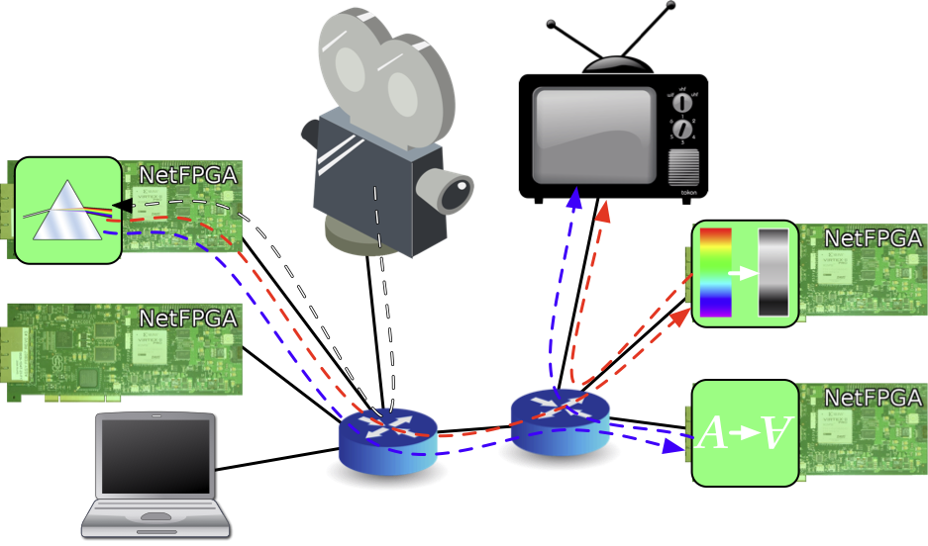
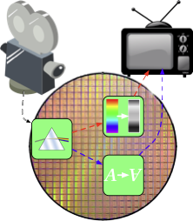

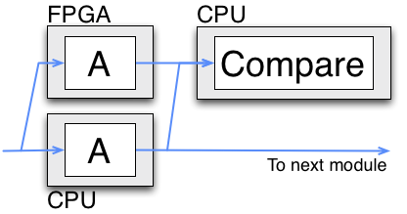
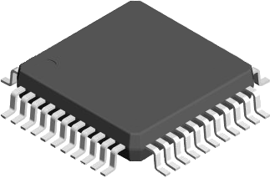
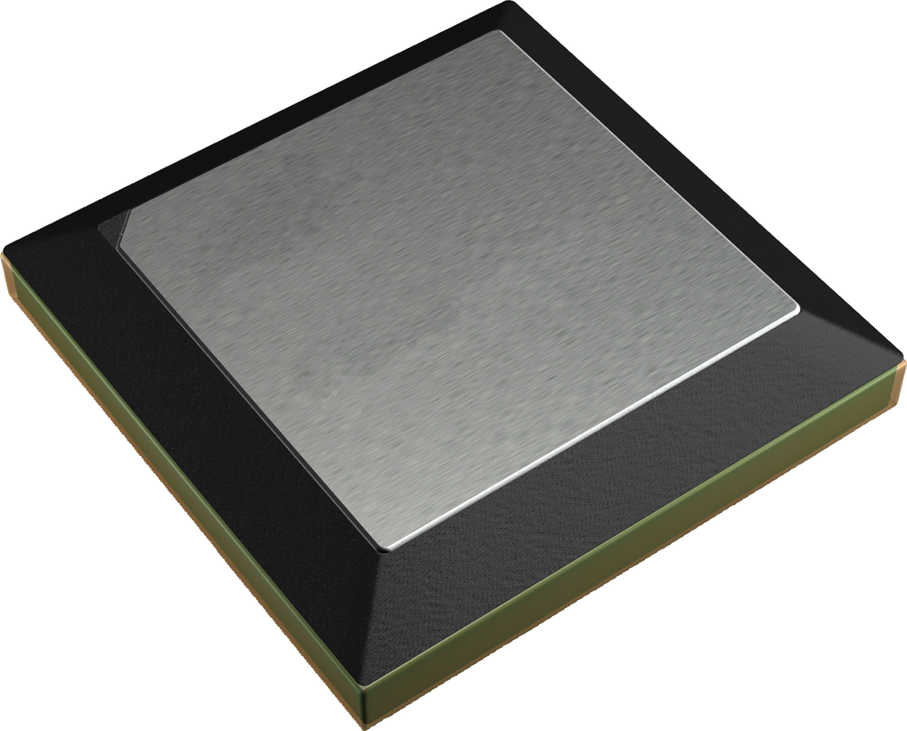

OpenPipes
Plumbing with OpenFlow to build hardware systems
Partition hardware designs
Mix resources
Test

Slide 97
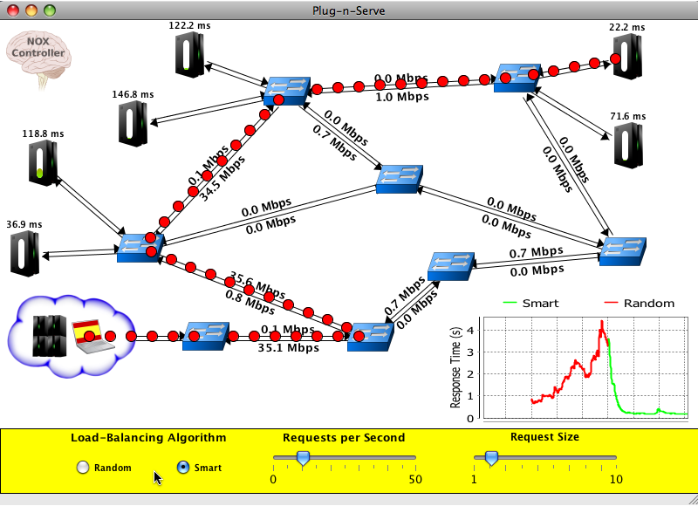
Plug-n-Serve:
Load-Balancing Web Traffic using OpenFlow
Goal: Load-balancing requests in unstructured networks
What we are showing
OpenFlow-based distributed load-balancer
Smart load-balancing based on network and server load
Allows incremental deployment of additional resources
OpenFlow means…
Complete control over traffic within the network
Visibility into network conditions
Ability to use existing commodity hardware
This demo runs on top of the FlowVisor, sharing the same physical network with other experiments and production traffic.

Slide 98
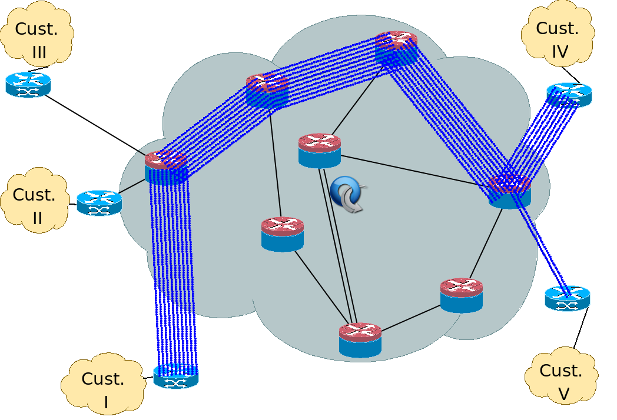
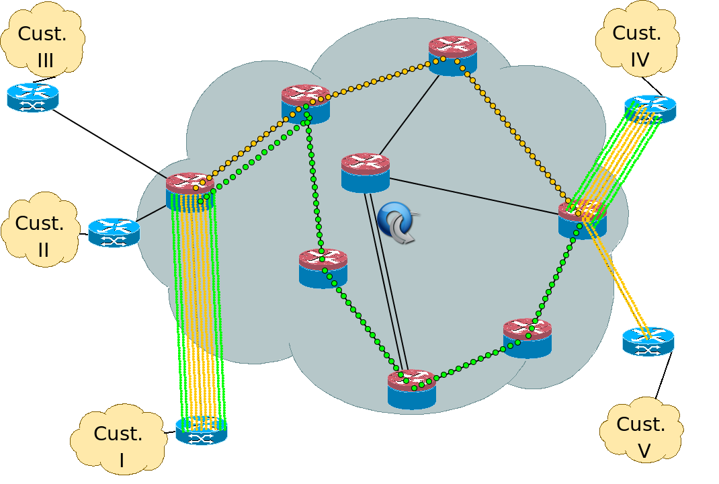
Dynamic Flow Aggregation on an OpenFlow Network
Scope
Different Networks want different flow granularity (ISP, Backbone,…)
Switch resources are limited (flow entries, memory)
Network management is hard
Current Solutions : MPLS, IP aggregation
How OpenFlow Helps?
Dynamically define flow granularity by wildcarding arbitrary header fields
Granularity is on the switch flow entries, no packet rewrite or encapsulation
Create meaningful bundles and manage them using your own software (reroute, monitor)
Higher Flexibility, Better Control, Easier Management, Experimentation

Slide 99
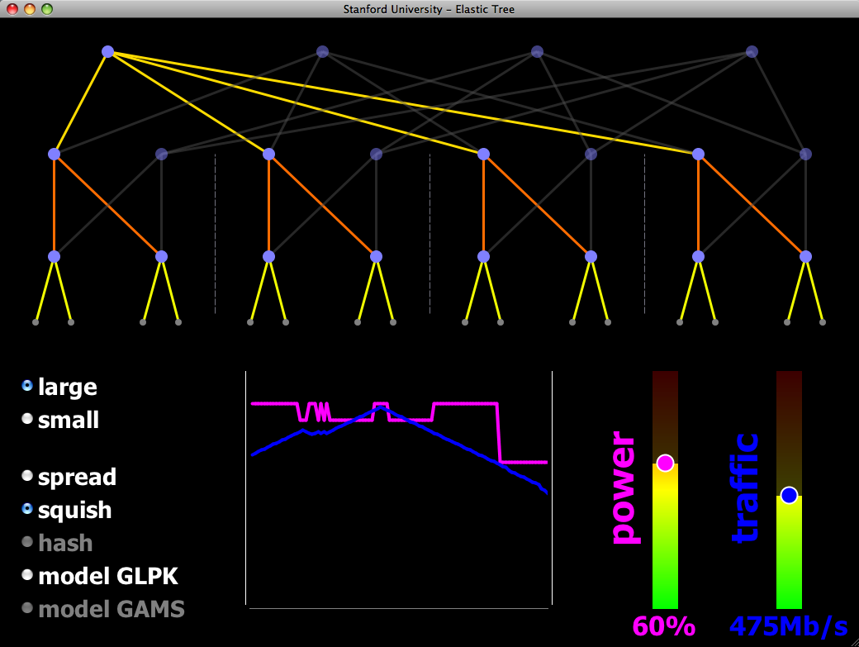
ElasticTree: Reducing Energy in Data Center Networks
Shuts off links and switches to reduce data center power
Choice of optimizers to balance power, fault tolerance, and BW
OpenFlow provides network routes and port statistics
The demo:
Hardware-based 16-node Fat Tree
Your choice of traffic pattern, bandwidth, optimization strategy
Graph shows live power and latency variation
demo credits: Brandon Heller, Srini Seetharaman, Yiannis Yiakoumis, David Underhill

Slide 100
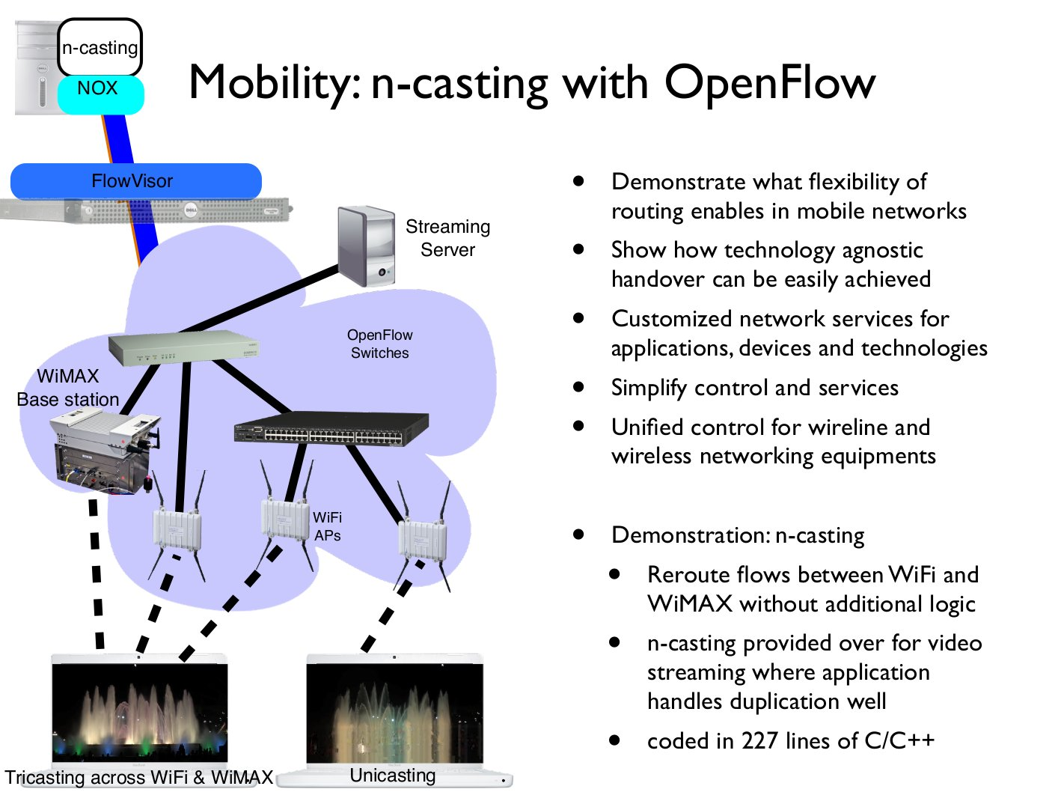

Slide 101
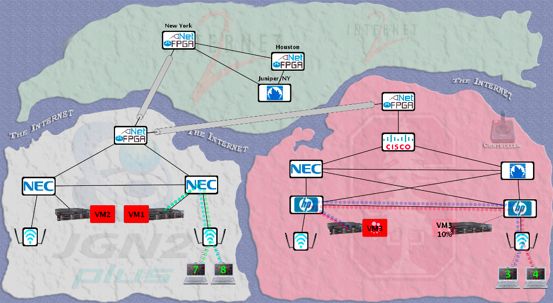
Intercontinental VM Migration
Moved a VM from Stanford to Japan without changing its IP.
VM hosted a video game server with active network connections.

Slide 102
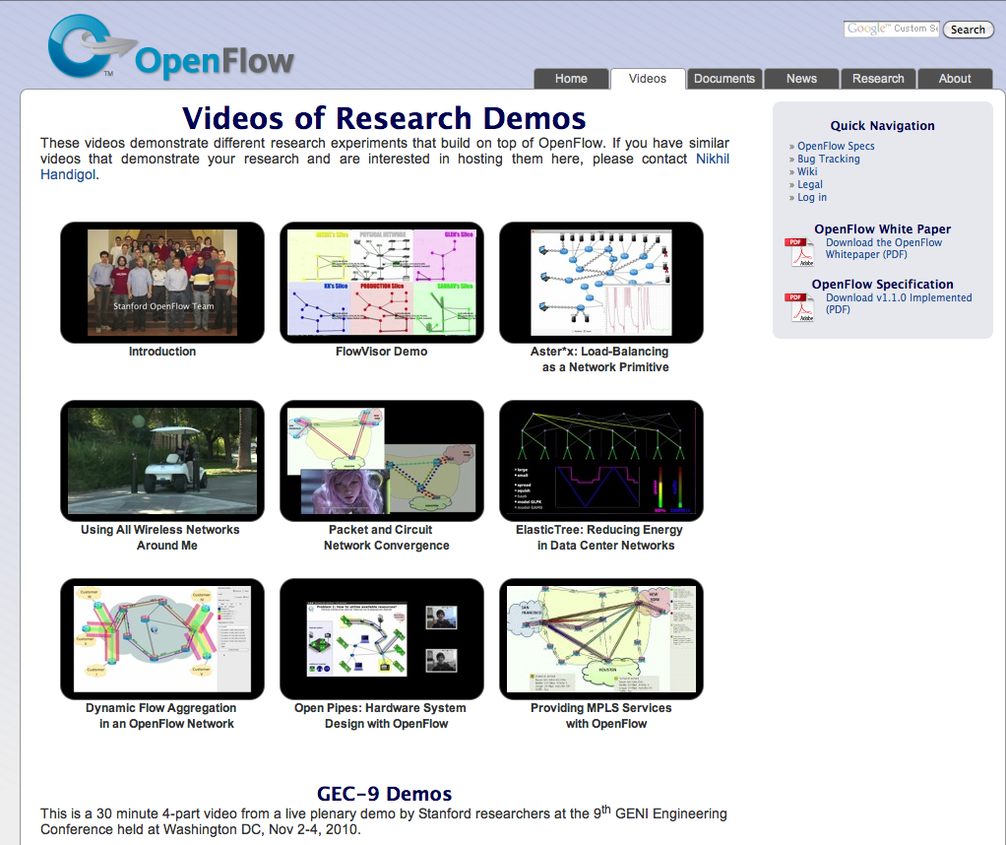
openflow.org/videos

Slide 103
Play Videos: Wireless Handover Load balancing

Slide 104
Times are changing
No longer “what can I now do that I couldn’t do before”
Clouds
Cost efficiency
Manageability
Programmability

Slide 105
Where SDN make sense (and doesn’t)
[from Martin Casado’s blog: http://networkheresy.wordpress.com/2011/11/17/is-openflowsdn-good-at-forwarding/]
So the question really boils down to whether the algorithm needed to compute the datapath state is easily distributed ... if the state management algorithm has any of the following properties it probably isn’t, and is therefore a potential candidate for SDN.
It is not amenable to being split up into many smaller pieces (as opposed to fewer, larger instances). The limiting property in these cases is often excessive communication overhead between the control nodes.
It is not amenable to running on heterogeneous compute environments. For example those with varying processor speeds and available memory.

Slide 106
Where SDN make sense (and doesn’t)
[from Martin Casado’s blog: http://networkheresy.wordpress.com/2011/11/17/is-openflowsdn-good-at-forwarding/]
It is not amenable to relatively long RTT’s for communication between distributed instances. In the purely distributed case, the upper bound for communicating between any two nodes scales linearly with the longest loop free path.
The algorithm requires sophisticated distributed coordination between instances (for example distributed locking or leader election)

Slide 107
SDN stack
Monitoring/Debugging Tools
Applications
Controllers
Virtualization
Switches
Topology

Slide 108
Up Next:
1:00 - 3:00pm Controllers:
NOX/POX (Murphy)
Trema (Hideyuki)
Beacon (David)
Floodlight (Rob)
RouteFlow (video)
+ more Q&A

Slide 109
Q & A

Slide 110
Getting Started
(1) Copy to your hard disk from a USB Key or DVD:
Copy needed files (VirtualBox, terminal, possibly an X server) for your platform (Win/Mac/Linux)
Copy Java 6 and Eclipse for your platform, if you want to use Java
Copy VM image: OpenFlowTutorial-101311.zip
Pass on the DVD or USB key to someone else!
(2) Unzip OpenFlowTutorial-101311.zip
(3) Point browser to instructions:
http://www.openflow.org/wk/index.php/OpenFlow_Tutorial (note the underscore)
You should NOT need to download any large files – spare the WiFi!

Slide 111
Break
Come back at 1:00 for Controllers

Slide 112
Controllers

Slide 113
POX: Murphy McCauley Beacon: David Erickson Trema: Hideyuki Shimonishi Floodlight: Rob Sherwood

Slide 114
VM Setup/Overview

Slide 115
[Hands-on Tutorial] Overview

Slide 116
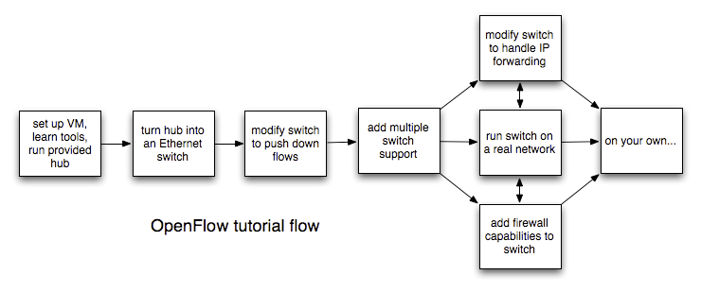
TutorialFlow

Slide 117
Stuff you’ll use
Ref Controller / NOX / Beacon / Trema / Floodlight
Open vSwitch
Mininet
iperf
tcpdump
Wireshark

Slide 118
Tutorial Setup
Controller
port6633
c0
loopback
(127.0.0.1:6633)
OpenFlow Tutorial
3hosts-1switch
topology
OpenFlow Switch
loopback
(127.0.0.1:6634)
dpctl
(user space process)
s1
s1-eth0
s1-eth1
s1-eth2
h1-eth0
h3-eth0
h4-eth0
h2
10.0.0.2
h3
10.0.0.3
h4
10.0.0.4
virtual hosts

Slide 119
Pick a controller!

Slide 120
POX: Murphy McCauley Beacon: David Erickson Trema: Hideyuki Shimonishi Floodlight: Rob Sherwood

Slide 121

Hands-on Tutorial
Instructions at:
www.openflow.org/wk/index.php/OpenFlow_Tutorial

Slide 122
Q&A

Slide 123
Deployment
Experiences

Slide 124
Deployment: Srini Seetharaman

Slide 125
Wrap-Up

Slide 127

























Growing Community
Vendors and start-ups
Providers and business-unit
More...
More...
Note: Level of interest varies
127

Slide 128
Closing Thoughts
SDN & OpenFlow
Open Source Ecosystem
SDN Switches and Controllers are available, used, and improving: open & closed
These are the early stages for SDN
Notes:
Plenty of stuff left to do.
Early stages: plenty of time to get involved and contribute a new piece.

Slide 129
Get involved!
Ask and answer questions on mailing lists:
openflow-discuss
openvswitch-{discuss/dev}
ONF forums
Share via wiki, github, etc.
Submit bug-reports and/or patches to OF reference implementation and Open vSwitch
Release open-source applications
Write a new controller!

Slide 130
This tutorial wouldn’t be possible without:
Speakers
Rob Sherwood
David Erickson
HIDEyuki Shimonishi
Murphy McCauley
Srini Seetharaman

Slide 131
ACKs
(acknowledgements)

Slide 132
This tutorial wouldn’t be possible without:
OpenFlow Experts
Tatsuya Yabe
Nikhil Handigol
TY Huang
James Hongyi Zeng
Bob Lantz
Masahiko Takahashi
Ali Al-Shabibi
Ali Yahya
Glen Gibb

Slide 133
This tutorial wouldn’t be possible without:
Past slides from:
Nick McKeown
Rob Sherwood
Guru Parulkar
Srini Seetharaman
Yiannis Yiakoumis
Guido Appenzeller
Masa Kobayashi
Scott Shenker
others

Slide 134
This tutorial wouldn’t be possible without:
Behind-the-scenes organizers:
Flora Freitas
Asena Gencel
Guru Parulkar

Slide 135
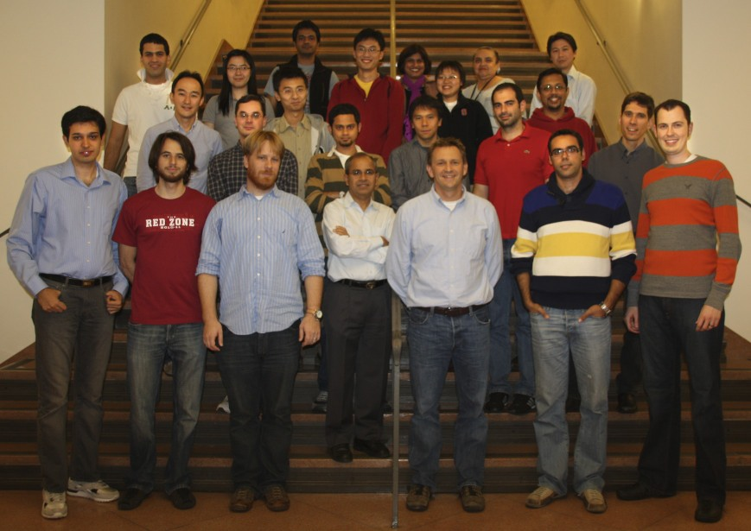
SDN Team at Stanford
Thanks!

